Slide 1

Project Title :-Seasonal Agriculture Performance Analysis
Student name:-Ashutosh kumar
College Name-Shivalik college of engineering
AICTE STU ID : (STU69e798523e4941776785490)

Slide 2

PROBLEM STATEMENT
(Agricultural activities are influenced by seasonal variations in environmental conditions, farming practices, resource availability and market conditions. As a result, agricultural performance may differ from one season to another. However, raw agricultural data does not clearly explain how agricultural performance changes across seasons or what patterns can be observed in different seasonal conditions. The problem is to analyze the given agricultural dataset and investigate seasonal differences in agricultural performance by identifying meaningful patterns, trends, relationships and variations within the available data.

Slide 3
Project description:-
Seasonal Agriculture Performance Analysis is a data analytics project that analyzes agricultural performance across different seasons, crops, and regions. The project examines factors such as rainfall, temperature, soil conditions, irrigation, fertilizer usage, yield, production, revenue, cost, and profit to identify seasonal patterns and performance differences.
Using Python, Pandas, NumPy, Matplotlib, Seaborn, and statistical analysis, the project converts raw agricultural data into meaningful insights. The analysis helps understand how environmental and resource-related factors are associated with agricultural outcomes and provides data-driven recommendations for better seasonal planning and resource management.

Slide 4

WHO ARE THE END USERS?
Farmers – To improve crop selection and seasonal planning.
Agricultural Departments – To monitor agricultural performance across seasons and regions.
Agribusinesses & Cooperatives – To understand crop production, resource usage, and profitability.
Irrigation & Resource Managers – To improve water usage and irrigation efficiency.
Agricultural Researchers & Analysts – To study seasonal trends and agricultural patterns.
Policy Makers – To support data-driven agricultural planning and decision-making.

Slide 5

Technology Used:-
Python – Data analysis and processing
Pandas – Data cleaning, manipulation, and analysis
NumPy – Numerical computations
Matplotlib – Data visualization
Seaborn – Statistical and advanced visualizations
SciPy – Statistical analysis and ANOVA
Jupyter Notebook – Development and analysis environment

Slide 6
Data overview and Quality check :-
Parameter | Result
Total Rows | 4,000
Total Columns | 28
Missing Values | 120
Columns with Missing Values | 4
Duplicate Rows | 0
Seasons | 3
Crops | 8
States | 8
Missing Values Detail:
Rainfall_mm → 48
Soil_Moisture_pct → 40
Yield_Tonnes_Ha → 32
Conclusion:-Data contained 4,000 records with 28 variables. A total of 120 missing values were identified, while no duplicate records were found. The data was cleaned and prepared before further analysis.

Slide 7
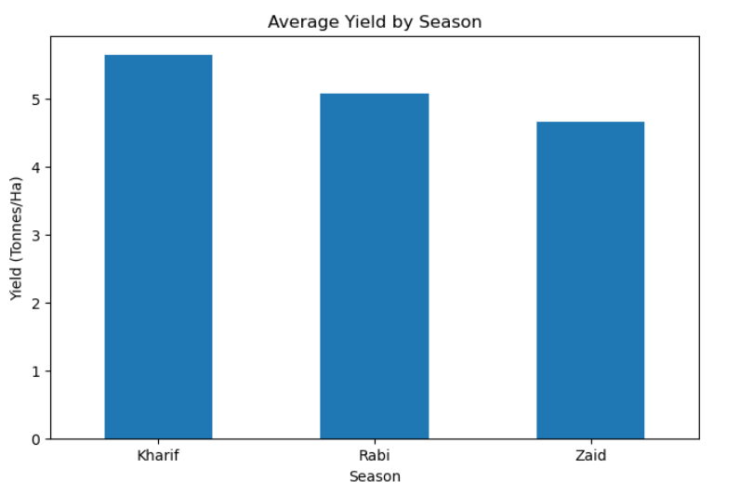
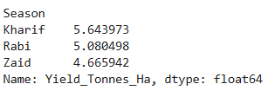
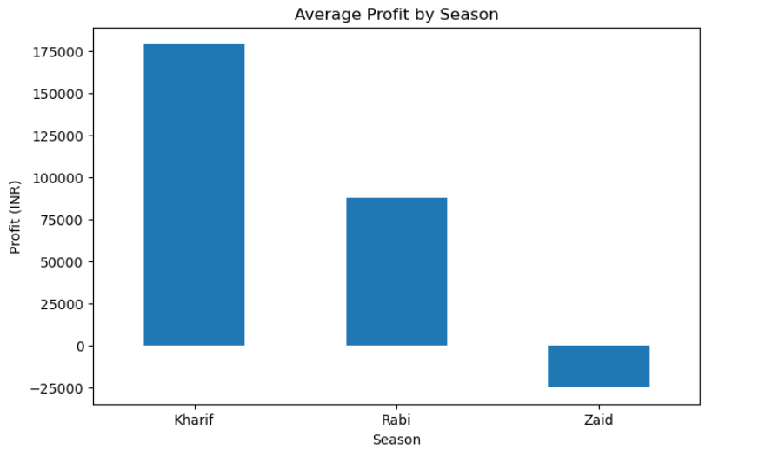
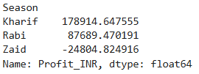
RESULTS:-Seasonal performance and pattern
Outcomes:-kharif showed the highest average yield, while Zaid showed the lowest
Outcomes:-Kharif performed better economically, while Zaid recorded an average loss.

Slide 8
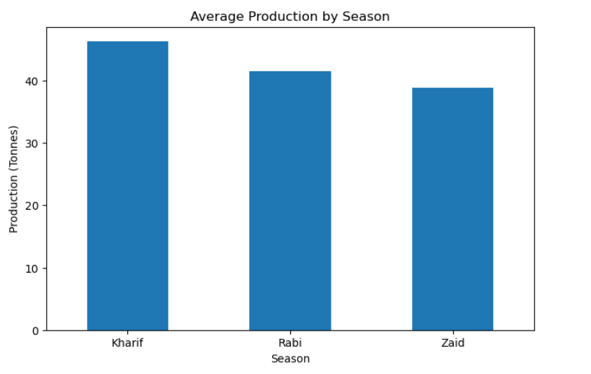
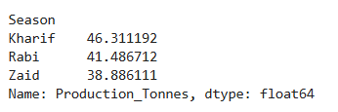
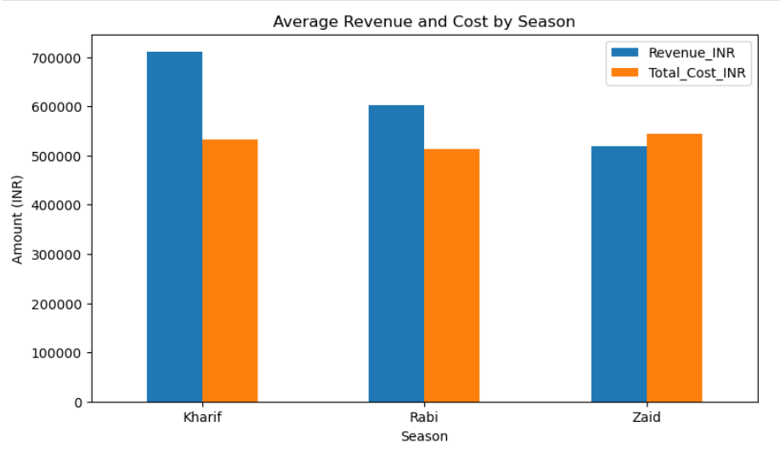
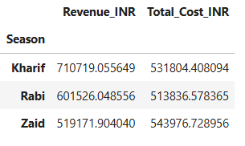
RESULT:-
Average production by season
Revenue and cost comparision

Slide 9
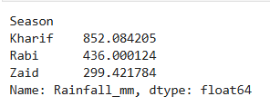
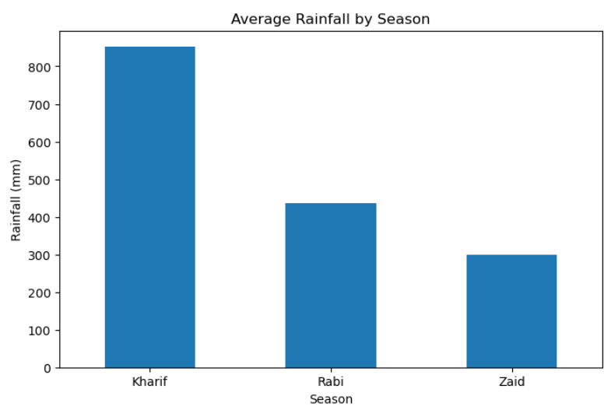
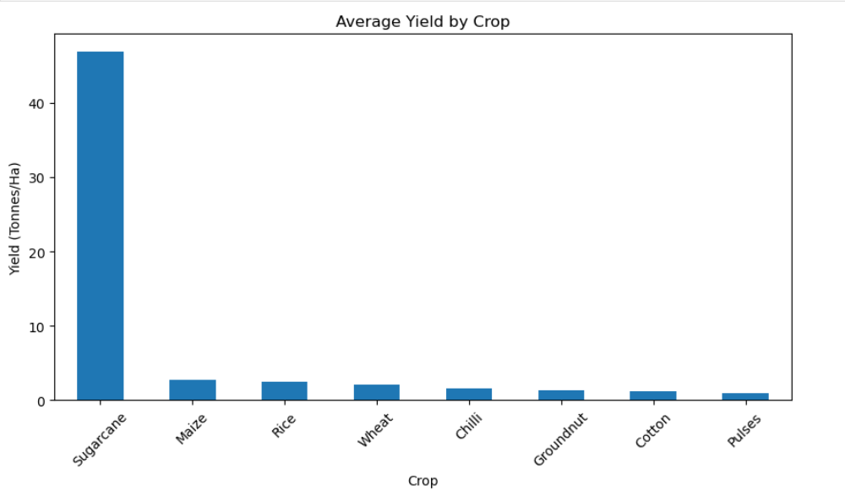
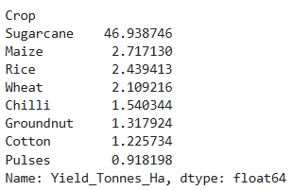
Average rainfall by season
Average yield by crop

Slide 10
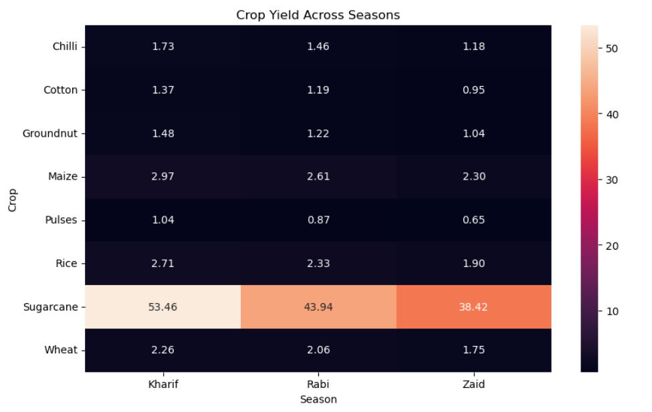
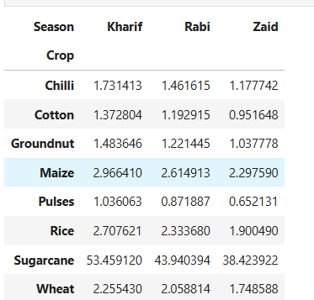
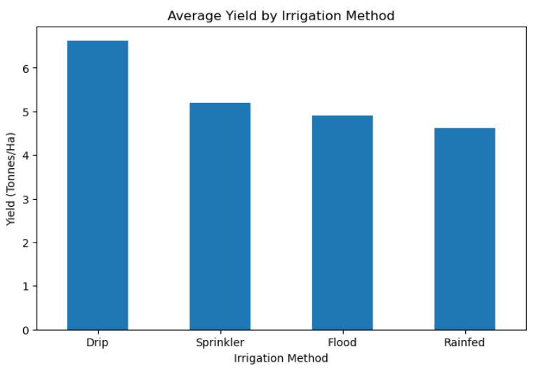
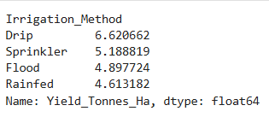
Crop yield across season
Average Yield by irrigation method

Slide 11
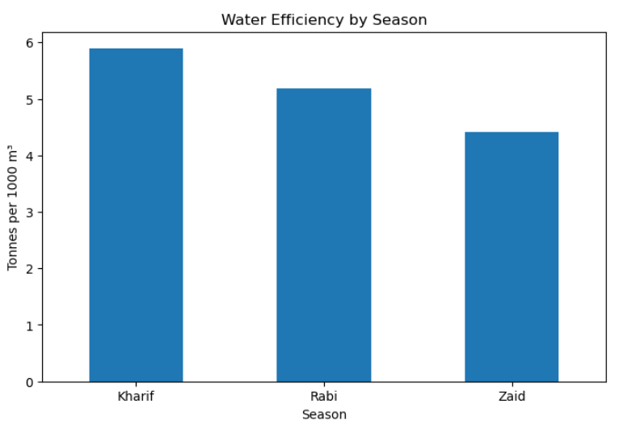
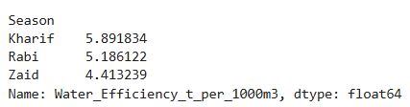
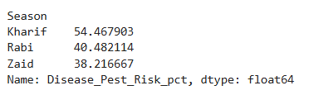
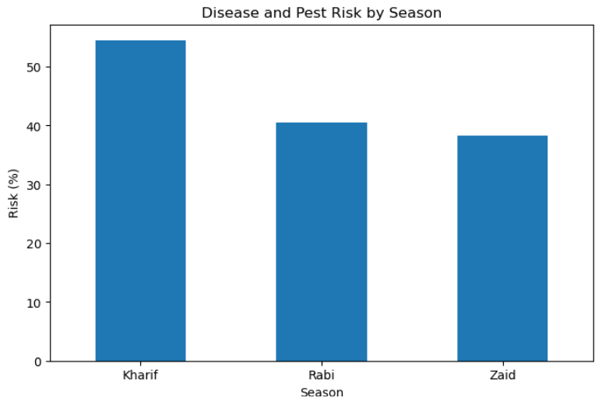
Water efficiency by season
Disease and pest risk by season

Slide 12
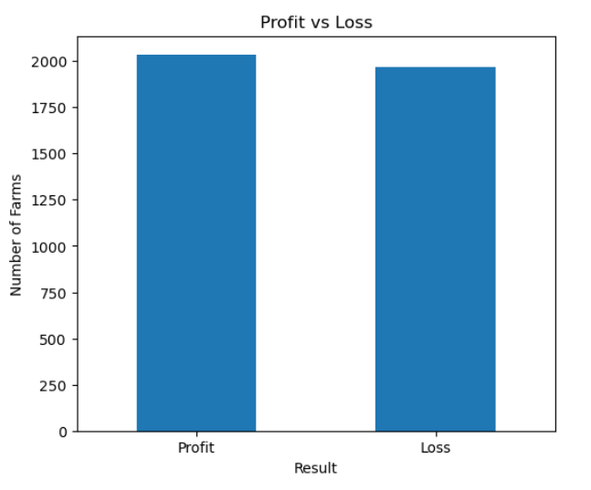
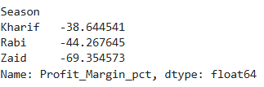

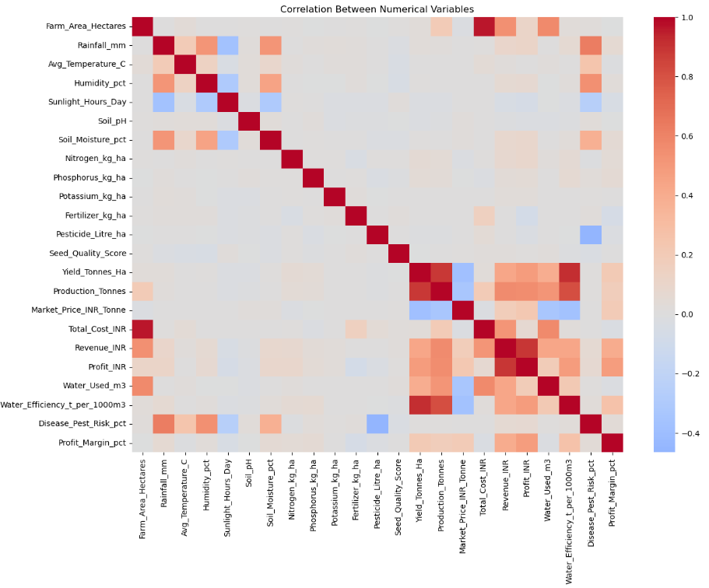
profit margin by season
profit and loss farms
correlation matrix

Slide 13
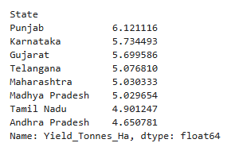
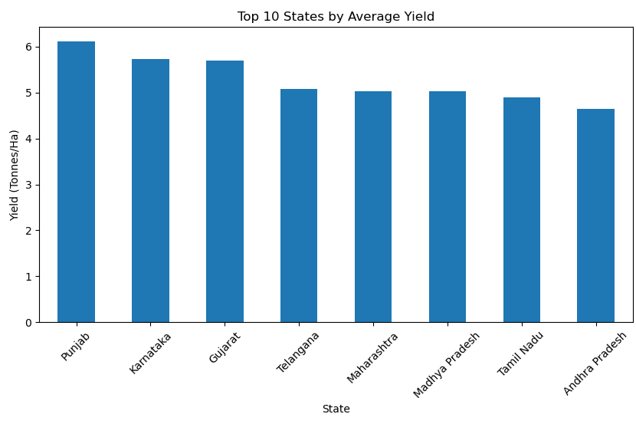
State wise Yield

Slide 14
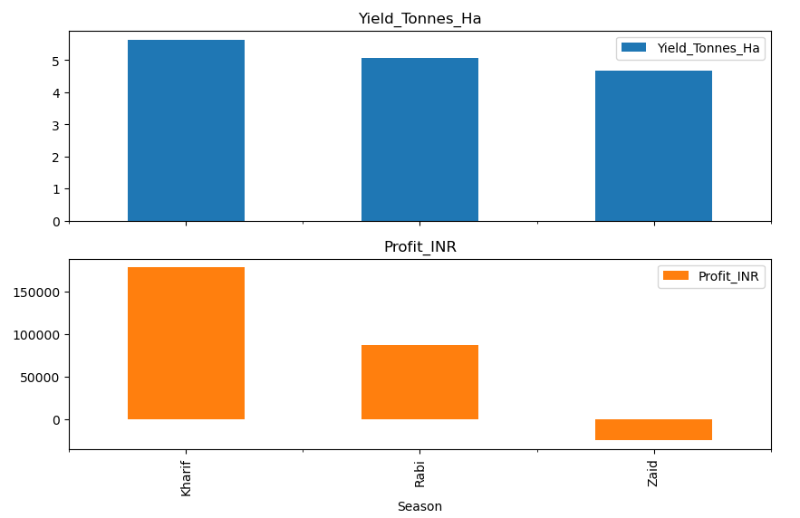
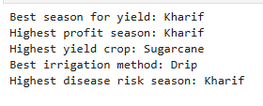
SUMMARY:-

Slide 15
Overall Insights:-
🌾 Agricultural Performance
.Kharif season recorded the highest average yield (5.64 t/ha) and production (46.31 tonnes).
.Zaid season showed the lowest average yield (4.67 t/ha) and production (38.89 tonnes).
.Sugarcane had the highest average yield among crops (46.94 t/ha).
💰 Economic Performance
.Kharif generated the highest average revenue (₹7.11 lakh) and profit (₹1.79 lakh) per record.
.Zaid showed the weakest economic performance, with an average loss of ₹24,805.
.Revenue and cost patterns indicate that higher production does not always translate into higher profitability.
🌦️ Environmental Factors
.Kharif had the highest rainfall (852.08 mm) and soil moisture (31.20%).
.Zaid had the highest average temperature (31.04°C) but the lowest soil moisture (19.17%).
.Rainfall showed only a weak correlation with yield, indicating that yield depends on multiple factors.
💧 Irrigation & Water Efficiency
.Drip irrigation achieved the highest average yield (6.62 t/ha).
.Water efficiency showed a strong positive association with yield (r = 0.915).
.This highlights the importance of efficient water management in agricultural performance.
📊 Statistical & Correlation Insights
.ANOVA gave p = 0.233 (> 0.05), so seasonal differences in mean yield were not statistically significant at the 5% level.
.Yield had strong associations with water efficiency (r = 0.915) and production (r = 0.885).
.Fertilizer, rainfall and major soil nutrients showed relatively weak direct correlations with yield.

Slide 16
FUTURE SCOPE:-
Real-Time Data Integration – Live weather, rainfall, soil and market-price data can be integrated for continuous monitoring.
Crop Yield Prediction – Machine Learning models can be developed to predict crop yield before harvesting.
Crop Recommendation System – Farmers can be recommended suitable crops based on season, soil and environmental conditions.
Weather-Based Farming Insights – Weather forecasts can be combined with historical data to support better seasonal planning.
. Advanced Regional Analysis – More states, districts and farms can be included to identify region-specific agricultural patterns.
Smart Irrigation Optimization – Data-driven models can recommend efficient irrigation methods and water requirements.
Early Disease/Pest Detection – Historical risk data can be extended with AI/image-based techniques for early detection.
Interactive Decision-Support Dashboard – A Power BI dashboard can provide actionable insights for farmers, planners and agricultural organizations.
Conclusion:-The project can be extended from descriptive analysis to predictive and prescriptive analytics, helping stakeholders make smarter and more sustainable agricultural decisions.

Slide 17
GitHub Link
Ashutosh-dutta07 (Ashutosh kumar)

Slide 18
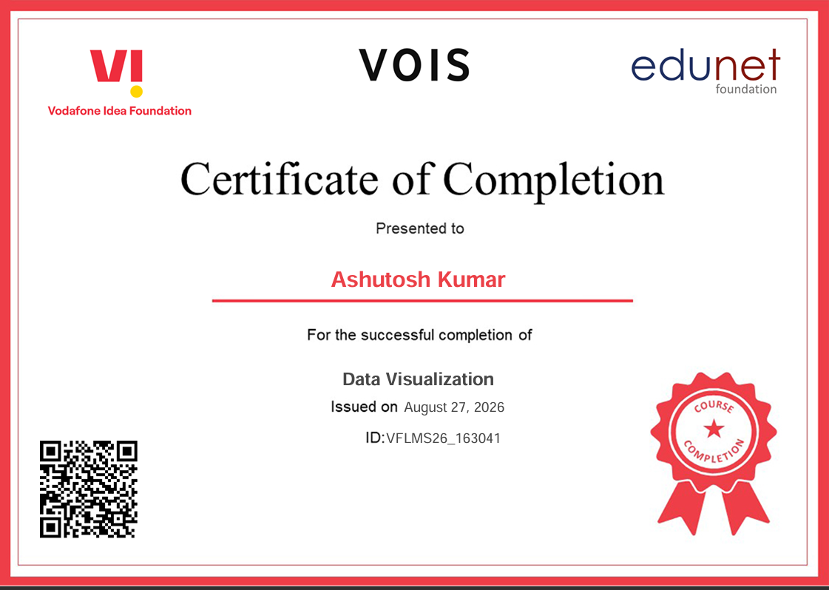
VOIS Course completion certificate - Course name- Data Visualization

Slide 19
Thank you
.
.

